Slide 1


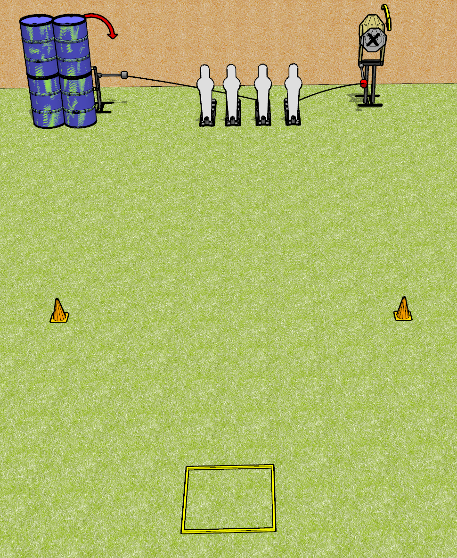
 | Dothan Gun Club – USPSA Match Yeet Course Designer : Drew Coleman
Round Count 8 rounds 2 IPSC 4 Pepper poppers
Equipment List Shooting box 2 cones Swinger + activator Max trap + activator

Slide 2
Yeet
Written Stage Briefing
Yeet is an 8 round, 40 point, Comstock speed shoot. There are 2 IPSC targets and 4 pepper poppers. The best 2 hits on paper will score, and steel must fall to score. The start signal is audible.
The swinger is activated by the left 2 pepper poppers. The max trap is activated by the right 2 pepper poppers. The swinger and the max trap are visible at rest and must be activated before being engaged. Please check the activators prior to walkthrough and set them the same way every time.
Handgun start position is in shooting box facing uprange, wrists above shoulders. Handgun is loaded and holstered.
PCC start position is in shooting box, muzzle pointed at either orange cone. Loaded carbine is held with both hands, safety on.
On start signal, engage targets as they become available from within the shooting area.

